Slide 1


AI Medical Chatbot Using LangChain, Chainlit, Torch
This presentation explores the development of an AI-powered medical chatbot utilizing LangChain, Chainlit, and PyTorch. This innovative project aims to provide patients with accessible and accurate medical information, assisting them in understanding their health concerns and navigating the complexities of the healthcare system.

Slide 2

Introduction to AI Chatbots in Healthcare
1
Improving Patient Engagement
2
Reducing Healthcare Costs
AI chatbots can enhance patient engagement by providing 24/7 access to medical information and support.
By automating routine tasks and providing initial medical screening, chatbots can contribute to cost-efficient healthcare delivery.
3
Personalized Healthcare Experiences
4
Expanding Access to Healthcare
AI chatbots can tailor information and interactions to individual patient needs, promoting better health outcomes.
AI chatbots can bridge the gap in healthcare access for underserved populations, facilitating communication and support.

Slide 3
Overview of LangChain, Chainlit, and PyTorch
LangChain
Chainlit
PyTorch
LangChain provides a framework for building complex and intelligent conversational agents by integrating with large language models (LLMs).
Chainlit is a powerful tool for building and deploying chatbot interfaces, offering a user-friendly environment for creating and testing conversational flows.
PyTorch is a widely used machine learning library that enables the creation and training of neural networks for natural language processing tasks.

Slide 4
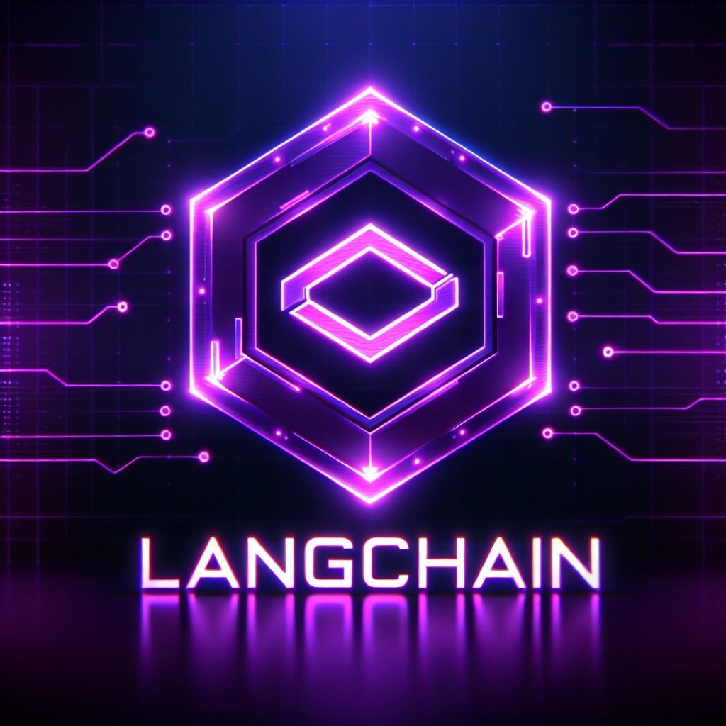
LangChain
LangChain is a powerful framework that simplifies the development of complex, intelligent chatbots by integrating with large language models (LLMs). It provides a structured approach to building conversational agents that can engage users in natural, contextual dialogues. Here are some key features of LangChain:
Integration with LLMs: LangChain allows seamless integration with various large language models, enabling developers to create applications like chatbots, content generators, and more
Data Handling: LangChain supports real-time data processing and integration, making it easier to work with dynamic data sources.
Community and Support: Being open-source, it has an active community that contributes to its development and provides support

Slide 5
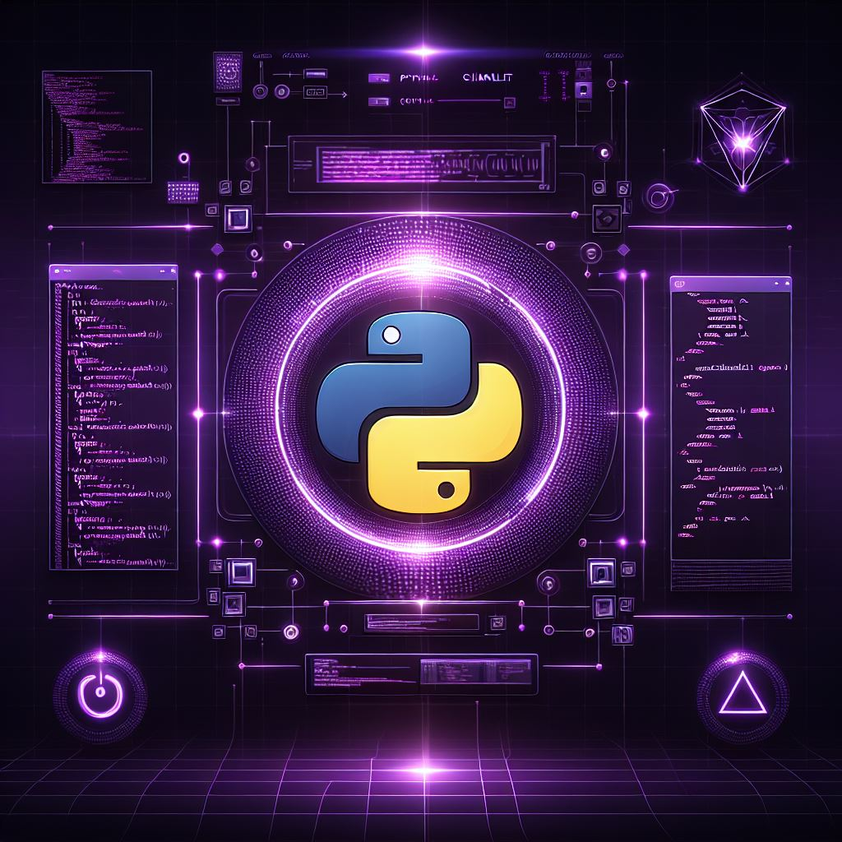
Chainlit
Chainlit is an open-source Python package designed to simplify the development and deployment of language model applications. It allows developers to create conversational AI applications quickly and efficiently. Here are some key features of Chainlit:
Ease of Use: You can integrate it seamlessly with existing code or start from scratch
in minutes.
Multi-Platform: Write your assistant logic once and use it across various platforms.
Data Persistence: Collect, monitor, and analyze data from your users.
Visualize Multi-Step Reasoning: Understand the intermediary steps that produced
an output at a glance.
Integrations: Compatible with popular libraries and frameworks like OpenAI,
LangChain, and more

Slide 6
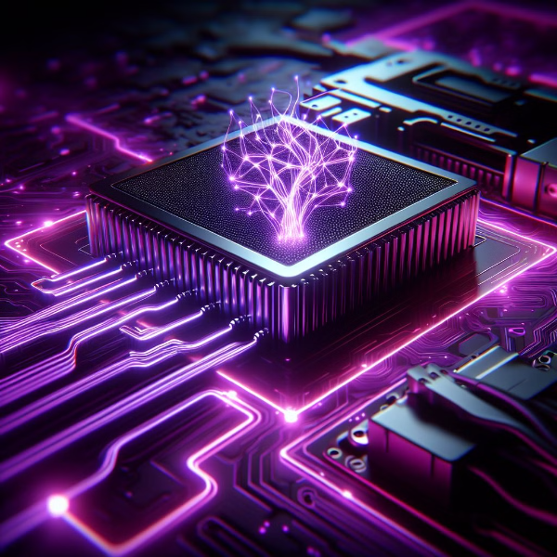
PyTorch
For checking the GPU is available in PyTorch, Torch.cuda module is used in the
model .
import torch
if torch.cuda.is_available():
print("GPU is available!")
else:
print("GPU is not available.")

Slide 7
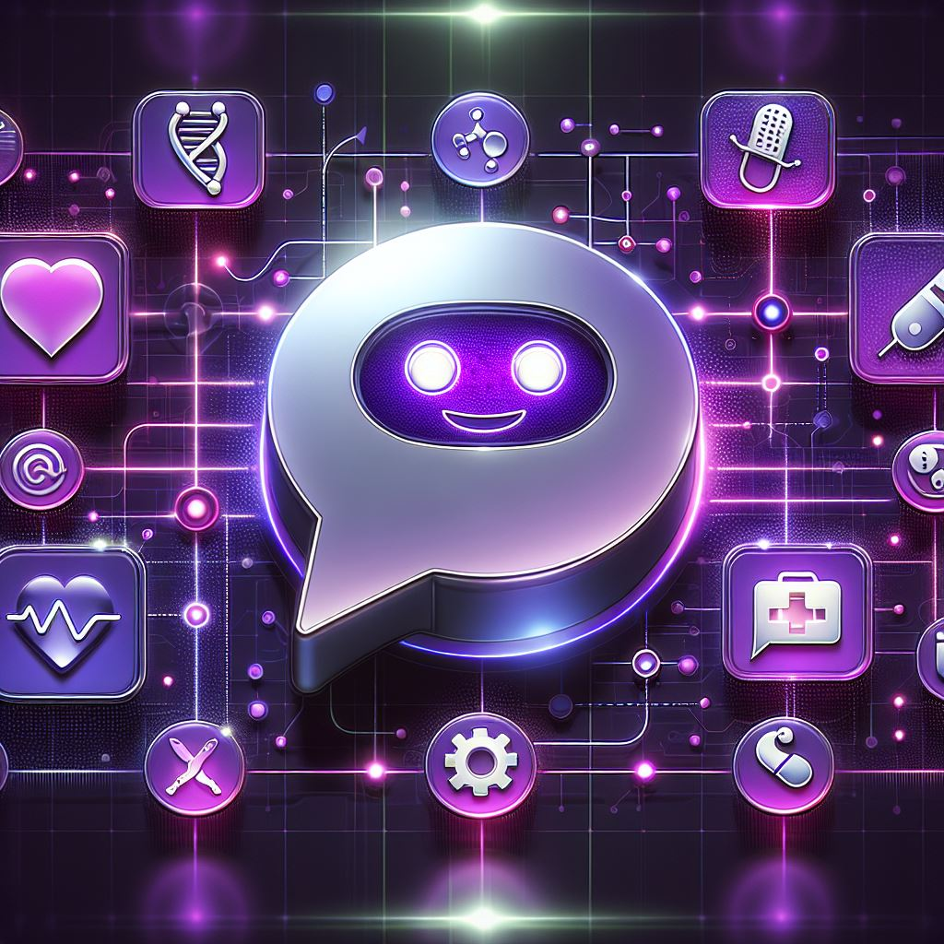




Designing the Chatbot Architecture
User Input
The chatbot receives user input through a conversational interface.
Natural Language Processing
The input is processed using natural language processing (NLP) techniques to understand the user's intent and extract relevant information.
Knowledge Base
The processed input is then matched against a comprehensive medical knowledge base.
Response Generation
The chatbot generates an appropriate response based on the user's intent and the knowledge base information.

Slide 8
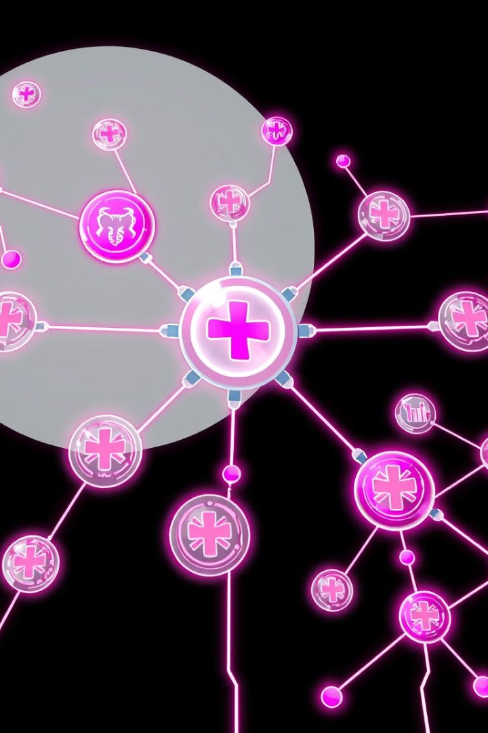
Incorporating Medical Knowledge Bases
Knowledge Domain
Description
Medical Terminology
A comprehensive vocabulary of medical terms, definitions, and concepts.
Disease Information
Information on various diseases, their symptoms, causes, treatments, and prognoses.
Drug Database
Detailed information about medications, including their effects, interactions, and potential side effects.

Slide 9
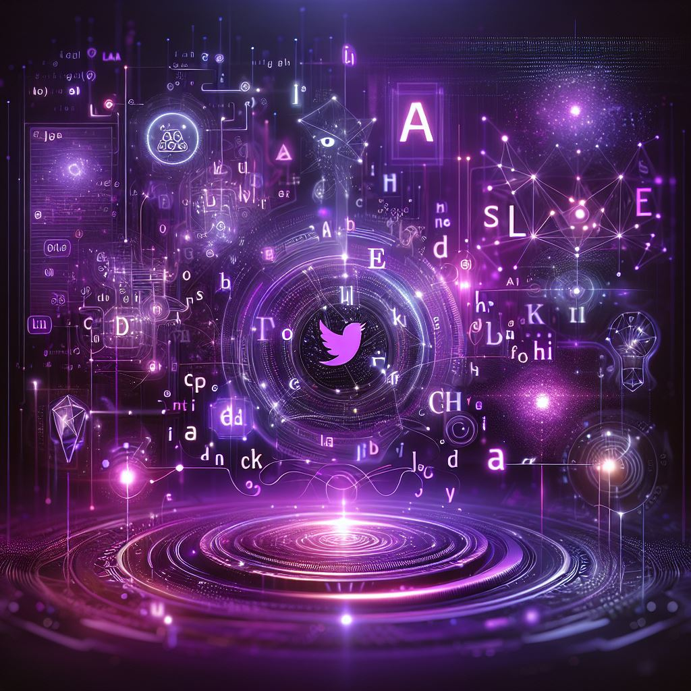




Natural Language Processing Techniques
Tokenization
Language Modeling
Breaking down text into individual words or units of meaning.
Predicting the next word in a sequence based on context.
Intent Recognition
Sentiment Analysis
Identifying the user's goal or purpose behind their query.
Detecting the emotional tone of the user's input.

Slide 10
Conversational Flow and User Experience
Greeting and Introduction
1
The chatbot welcomes the user and provides a brief overview of its capabilities.
2
User Query
The user inputs their medical query.
Information Gathering
3
The chatbot asks follow-up questions to clarify the user's query and gather relevant details.
4
Response Generation
The chatbot generates a concise and informative response based on the user's query and the knowledge base.
Feedback and Conclusion
5
The chatbot prompts the user for feedback and concludes the conversation.

Slide 11
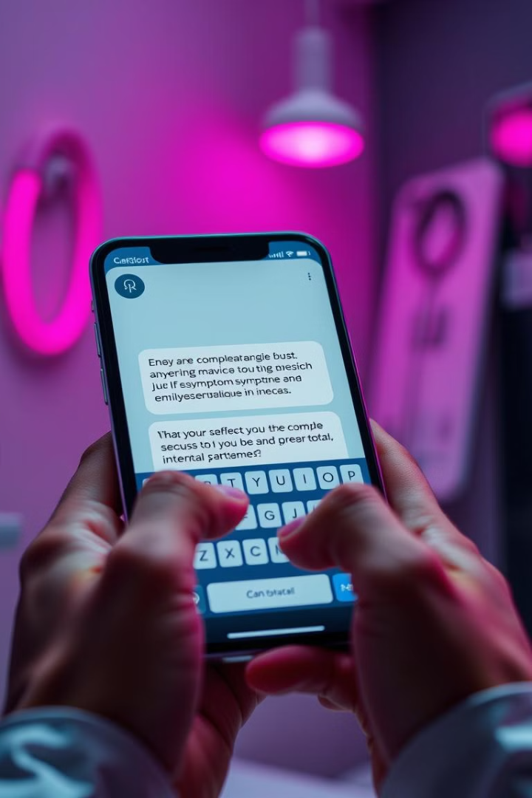
Handling Complex Medical Queries
Symptom Mapping
Differential Diagnosis
The chatbot maps user-reported symptoms to potential diagnoses.
The chatbot provides a list of possible diagnoses based on the user's symptoms and medical history.
Treatment Recommendations
Risk Assessment
The chatbot can assess the risk factors associated with specific conditions.
The chatbot suggests potential treatment options based on the identified diagnoses.

Slide 12



Security and Privacy Considerations
Data Encryption
Privacy Policies
Security Audits
Protecting patient data through strong encryption methods.
Implementing clear and comprehensive data privacy policies.
Regularly auditing the chatbot's security measures to identify and address vulnerabilities.

Slide 13
Thank You!

